Slide 1

A Survey of Encoding Techniques for Signal Processing in Spiking Neural Networks
Daniel Auge, et al., Neural Processing Letters 2021
2023-07-13(Thu)
Yusang Nam

Slide 2
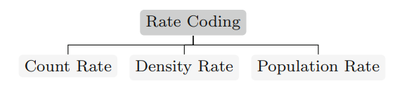
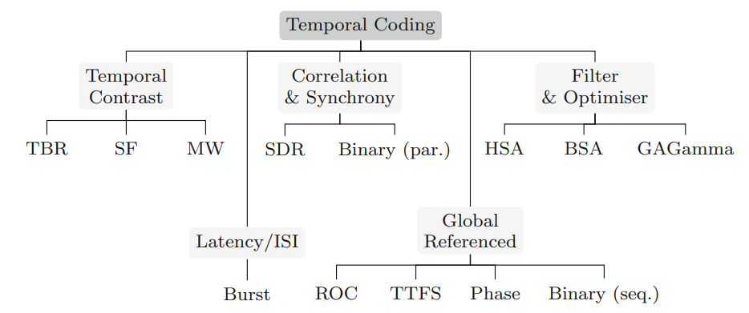
Encoding Trees
Two main categories – by exact timing and order
Rate Coding : No
Temporal Coding : Yes
Notes:
The encoding methods of SNN can be broadly categorized into two main types.
There are two main types of encoding methods in SNN: Rate Coding and Temporal Coding.
All specialized encoding schemes can be classified into these two categories based on whether the precise timing and order of spikes are crucial for conveying information.
Rate coding does not rely on precise timing and spike order, while temporal coding is crucial.

Slide 3

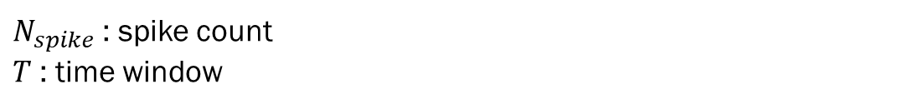
Rate Coding
Count Rate
Count Rate
$N_{spike}$ : spike count
$T$ : time window
Notes:
I will begin by explaining Rate coding.
The first method is count rate of Rate coding. The equation for this method is as follows: N represents spike count, and T represents the time window.
The figure below illustrates an example of count rate for a given stimulus.

Slide 4

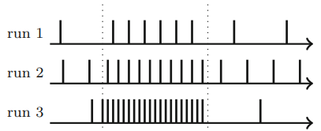
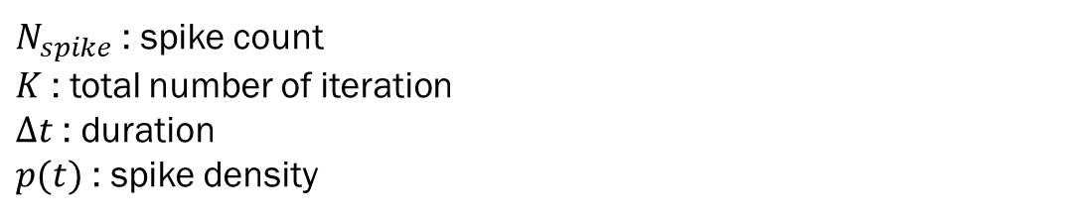
Rate Coding
Density Rate
Density Rate
Spike time
Exact
Random : often modelled by a Poisson distribution
$N_{spike}$ : spike count
$K$ : total number of iteration
$∆t$ : duration
$p(t)$ : spike density
Notes:
This equation represents how you can obtain the spike density by dividing the spike count for a specific duration by the total number of iterations.
Spike times can be either exact or random. If you choose random timing for spike times, it can be modeled using a Poisson distribution.

Slide 5

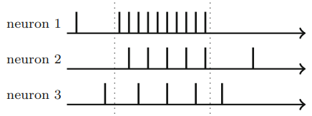
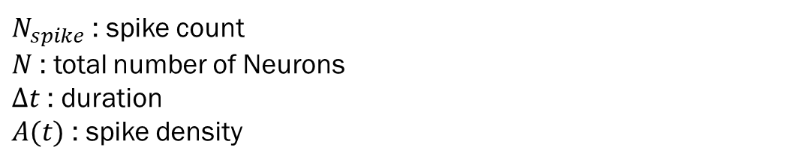
Rate Coding
Population Rate
Population Rate
Superposition
A population of neurons does not necessarily have to be uniform
$N_{spike}$ : spike count
$N$ : total number of Neurons
$∆t$ : duration
$A(t)$ : spike density

Slide 6
Encoding Trees
Two main categories – by exact timing and order
Rate Coding : No
Temporal Coding : Yes

Slide 7
Temporal Coding
Global Referenced
Global Referenced
TTFS
Phase
ROC
(sequential) Binary

Slide 8
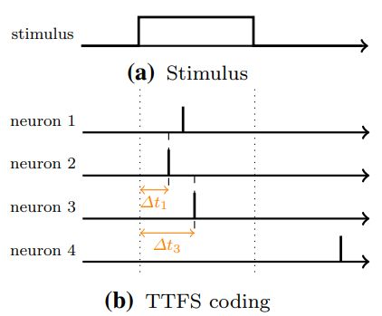

Temporal Coding
Global Referenced
Global Referenced
TTFS
TTFS : Time-To-First-Spike
Simple example
$∆t=1/a$
$∆t=1 −a$
$a$ : normalized signal amplitude
Notes:
This method encodes information by the time difference t between stimulus onset and the first spike of a neuron
As a simple example, the firing time can be determined as the inverse of the stimulus amplitude:
t = 1/a, or it can follow a linear relationship: t = 1 − a, where 'a' represents the normalized signal amplitude.

Slide 9
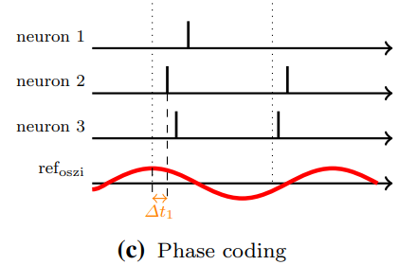

Temporal Coding
Global Referenced
Global Referenced
Phase
Phase
Time difference between
spikes and oscillation
Simple example
$∆t=1/a$
$∆t=1 −a$
$a$ : normalized signal amplitude
Notes:
In phase coding, oscillations occur periodically, and information can be encoded based on the difference between the peak of the oscillation and the onset timing of each neuron’s spike.

Slide 10
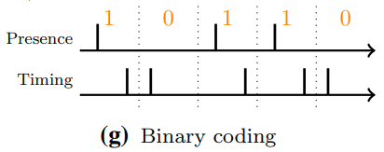
Temporal Coding
Global Referenced
Global Referenced
(sequential) Binary
Encoding a bit stream
Detail
Presence : Presence or absence of a spike
Timing : The timing of the spike within the
interval
Notes:
A bit stream can also be encoded as a spike train.
There are two sub-methods for this encoding.
The first method encodes a bit based on the presence or absence of a spike within a given time interval.
The second method encodes a bit based on the timing of the spike's onset within the interval.

Slide 11
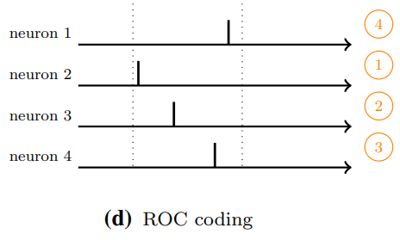
Temporal Coding
Global Referenced
Global Referenced
ROC
ROC : Rank-Order Coding
Detail
ROC is based on the firing order of population of neurons in relation to a global reference.
Notes:
ROC stands for Rank-Order Coding.
An example output can be found here.
With this method, the exact timing is disregarded.
Consequently, several authors have modified the model to incorporate the Inter-Spike Interval (ISI)

Slide 12
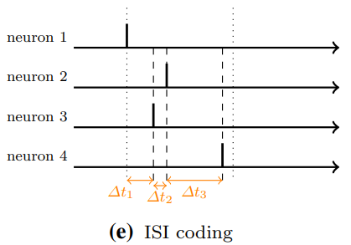
Temporal Coding
Latency/ISI
ISI
ISI
ISI : Inter-Spike-Interval
Burst
A group of spikes with
a very small ISI
Detail
The information is encoded into the relative time difference (latency) between the spikes of a neuron group
Notes:
ISI stands for Inter-Spike Interval, which refers to the time difference between successive spikes of a neuron group.
In this method, information is encoded based on the relative timing differences between spikes.
Additionally, the term "burst" is used when information is encoded through very short time intervals between spikes.

Slide 13
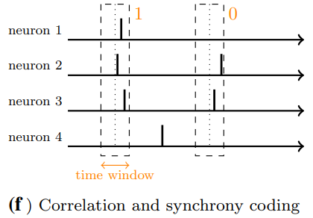
Temporal Coding
Correlation
& Synchrony
Correlation & Synchrony
SDR
Sparse Distributed Representations
Binary
Detail
Notes:
From this slide, the methods of encoding are not clearly understood.
Therefore, I will provide a simple introduction to the encoding methods.

Slide 14
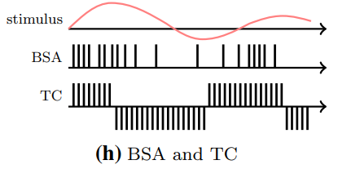
Temporal Coding
Filter
& Optimiser
Filter & Optimiser
HSA
Hough Spiker Algorithm
BSA
Ben’s Spiker Algorithm
GAGamma
Detail

Slide 15
Temporal Coding
Temporal
Constrast
Temporal Contrast
TBR
Threshold-Based Representation
SF
Step-Foward
MW
Moving-Window
Detail

